Slide 1
DESIGN & ANALYSIS OF ALGORITHM
PCC-CS404

Slide 2
PRE-REQUISITES
PROGRAMMING
DATA STRUCTURE & ALGORITHM
DISCRETE MATHEMATICS

Slide 3
Design & analysis of ALGORITHM Schedule ----topic wise
 | Topic | Sub Topic
1 | INTRODUCTION | Design of algorithm , Analysis of algorithm, Algorithm properties
2 | FRAMEWORK FOR ALGORITHM ANALYSIS | HOW TO COUNT EXECUTION TIME OF ALGORITHM,INPUT INSTANCES
3 | ASYMPTOTIC NOTATION | BEST CASE,AVERAGE CASE, WORST CASE
4 | SOLVING RECURRENCE RELATION | SUBSTITUTION METHOD, MASTER THEOREM
5 | ALGORITHM DESIGN TECHNIQUES | DIVIDE & CONQUER, GREEDY,DYNAMIC PROGRAMMING, BACKTRACKING,
6 | DISJOINT SET MANIPULATION | UNION ,FIND ALGORITHM & CYCLE DETCETION
7 | NETWORK FLOW PROBLEM | FORD FULKERSON ALGORITHM
8 | NP COMPLETENESS | NP,NP HARD………ALGORITHM
9 | APPROXIMATION ALGORITHM | COMPLEXITY ANALYSIS OF NP COMPETE PROBLEM

Slide 4
ALGORITHM
A sequence of computational steps that transform the input into the output.
Example - sorting problem:
Input: A sequence of n numbers a1; a2; : : : ;an.
Output: A permutation (reordering) (a’1; a’2; ……………….. a’n) of the input sequence such that
a’1<= a’2<=a’3…………………<=a’n.

Slide 5
Question
What type of approach is required to build an algorithm?

Slide 6
ALGORITHM : greatest common divisor
Algorithm 1: Simple level, School level
Algorithm 2: Euclid’s

Slide 7
ALGORITHM 1 : greatest common divisor (m,n)
Simple level, School level
Step 1 : Factorize M i.e M=m1 * m2 * m3…….
Step 2: Factorize N i.e N=n1 * n2 * n3……..
Step 3: Identify the common factor/factors.
Step 4: GCD= multiplication of common factors.
Step 5: return GCD

Slide 8
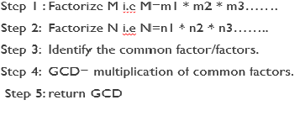
ALGORITHM 1 : greatest common divisor (m,n)
GCD(36,48)
Step 1 : M= 2*2*3*3
Step 2: N= 2*2*2*2*3
Step 3: Common Factor=2*2*3
Step 4: GCD=12

Slide 9
ALGORITHM 2 : greatest common divisor (m,n) n>=m
Euclidean Algorithm
Step 1 : r N mod M
Step 2: N M
Step 3: M r
Step 4: Repeat step 1to 3 while M doesn’t divide N
Step 5: return N

Slide 10
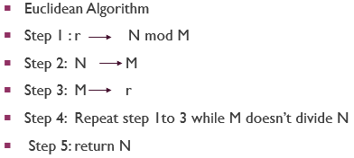
ALGORITHM 2 : greatest common divisor (m,n)
Euclidean Algorithm GCD(36,48)
Iteration 1: GCD(36,48) r=12 N=36 M=12
Iteration 2: GCD(12,36) r=0 N=12 M=0
Iteration 3: GCD=12

Slide 11
Analysis of ALGORITHM 1 & 2 greatest common divisor (m,n)
Euclidean Algorithm GCD(36,48)
Iteration 1: GCD(36,48) r=12 N=36 M=12
Iteration 2: GCD(12,36) r=0 N=12 M=0
Iteration 3: GCD=12
GCD(36,48)
Step 1 : M= 2*2*3*3
Step 2: N= 2*2*2*2*3
Step 3: Common Factor=2,2,3
Step 4: GCD=12

Slide 12
Question
GCD(434,966)
Step 1 : M= 2*7*31
Step 2: N= 2*7*139
Step 3: Common Factor=2,7
Step 4: GCD=2*7=14
Number of division? a) 6 b) 7 c) 8 d) many

Slide 13
Next class topic-
Frame work for Algorithm
Analysis.

